Slide 1


Hotel Management System
Presenter: Tahir Emre Semiz

Slide 2


Goals, Purposes And Scopes
Requirements and solution phases in the hotel management system
The most efficient and appropriate design patterns required for these solution phases
These selected design patterns should be coded efficiently and have a flexible structure

Slide 3
Open Source
Cross Platform
The system should cover basic functions such as bookings, room statuses, customer information and payment processing
By providing a user-friendly interface, it is intended that hotel staff and customers can easily use the system.
Make hotel operations more effective and flexible

Slide 4

This system should be able to successfully manage hotel operations, especially room and customer related hotel operations, increase customer satisfaction and make hotel operations more effective and flexible.
The system should cover basic functions such as bookings, room statuses, customer information and payment processing
By providing a user-friendly interface, it is intended that hotel staff and customers can easily use the system.

Slide 5
Design Patterns
Singleton Pattern
Factory Pattern
Observer Pattern
Strategy Pattern
Decorator Pattern

Slide 6
1 - Singleton Pattern
The Singleton pattern ensures that a class has only one instance and provides a global point of access to that instance.
The HotelManager class is implemented as a Singleton to ensure that there is only one instance managing the hotel.
It ensures that there is a single point of control for hotel-related operations.

Slide 7
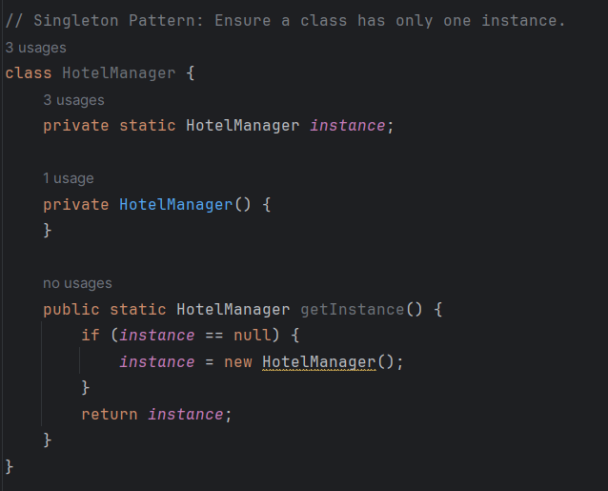

Slide 8

2 - Factory Pattern
The Factory pattern defines an interface for creating an object but lets subclasses alter the type of objects that will be created.
The Factory pattern allows the system to create rooms dynamically based on the type of room requested, enhancing flexibility.
New room types can be easily added to the system by adding new room functions to the code.

Slide 9
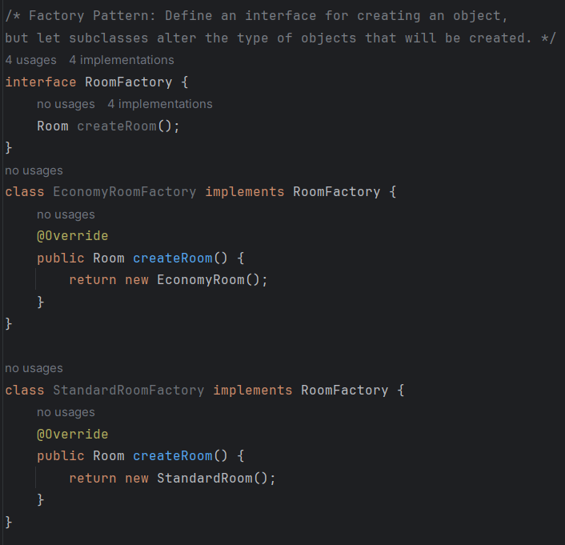

Slide 10

3 - Observer Pattern
The Observer pattern defines a one-to-many dependency between objects so that when one object changes state, all its dependents are notified and updated automatically.
The BookingObserver interface declares the update() method to notify observers of changes.
The Customer class implements the observer and is notified when significant events, such as booking updates, occur.

Slide 11
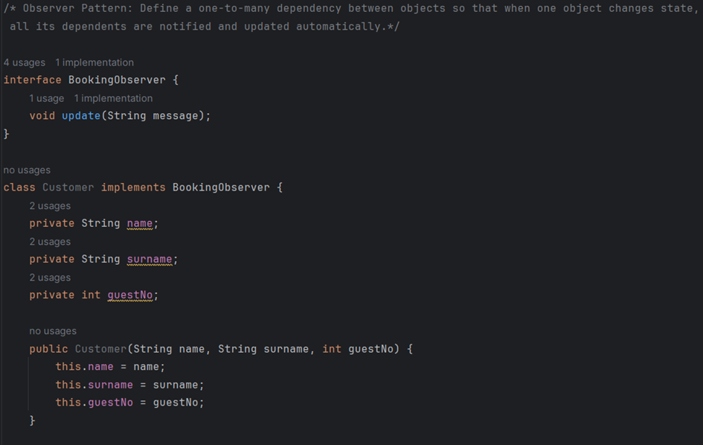

Slide 12
4 - Strategy Pattern
The Strategy pattern defines a family of algorithms, encapsulates each one, and makes them interchangeable. Strategy lets the algorithm vary independently from clients that use it.
The PaymentStrategy interface declares the pay() method for payment processing.
Concrete implementations like CreditCardPayment and CashPayment provide specific payment strategies.

Slide 13
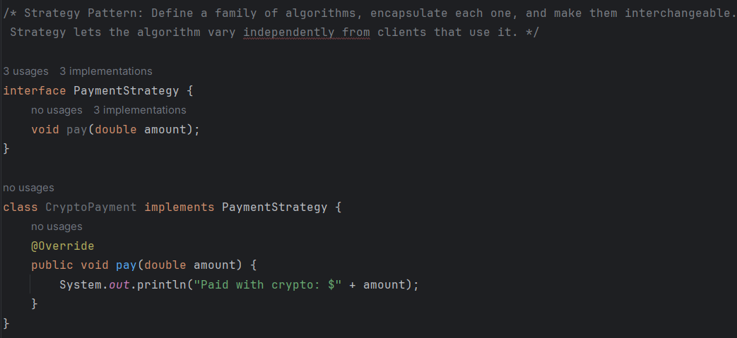

Slide 14
5 - Decorator Pattern
The Decorator pattern attaches additional responsibilities to an object dynamically. Decorators provide a flexible alternative to subclassing for extending functionality.
The RoomDecorator abstract class implements the Room interface and acts as the base decorator.
Concrete decorators like WiFiDecorator add specific features (e.g., WiFi) to the base Room.

Slide 15
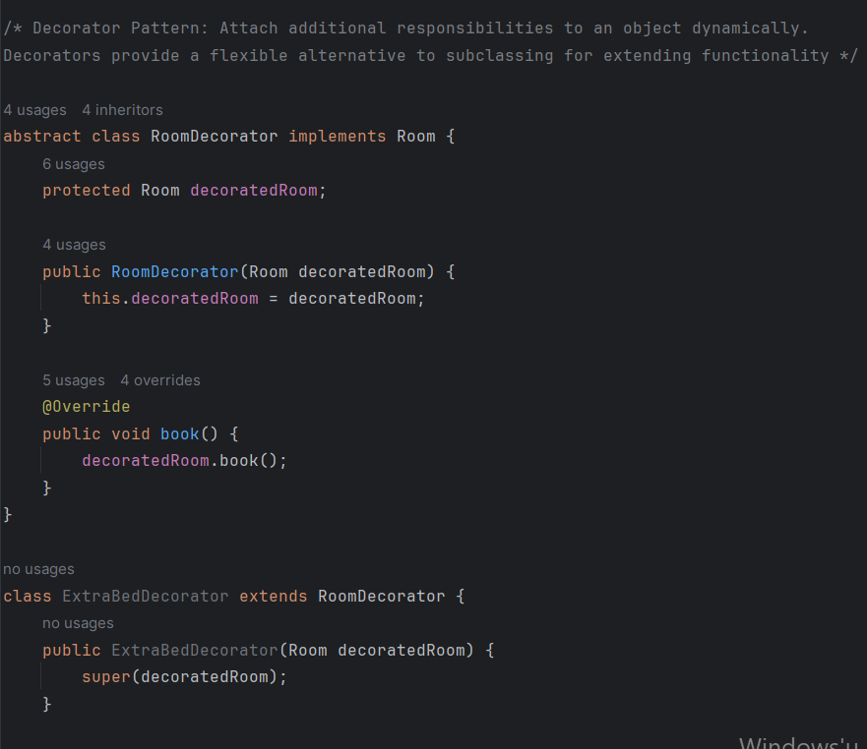

Slide 16
Relationships Between Design Patterns
Factory and Observer Patterns
Singleton and Factory Patterns
Decorator and Singleton Patterns
Observer and Strategy Patterns

Slide 17
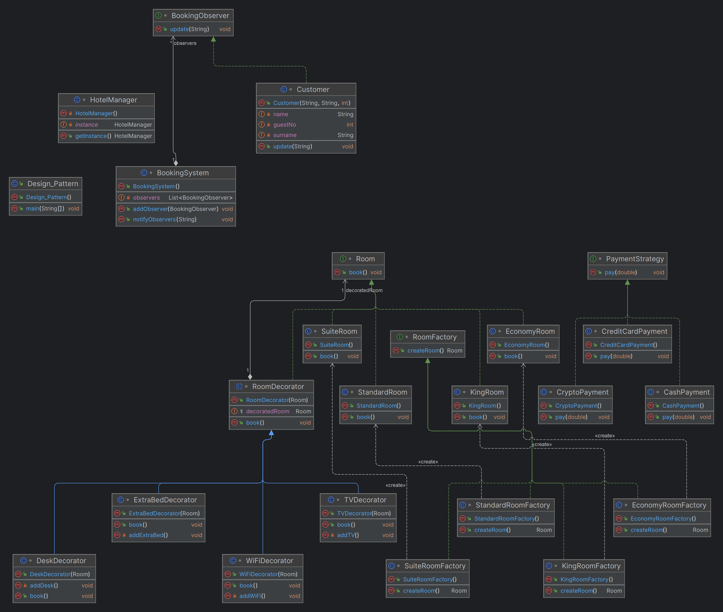

Slide 18

User Interface

Slide 19
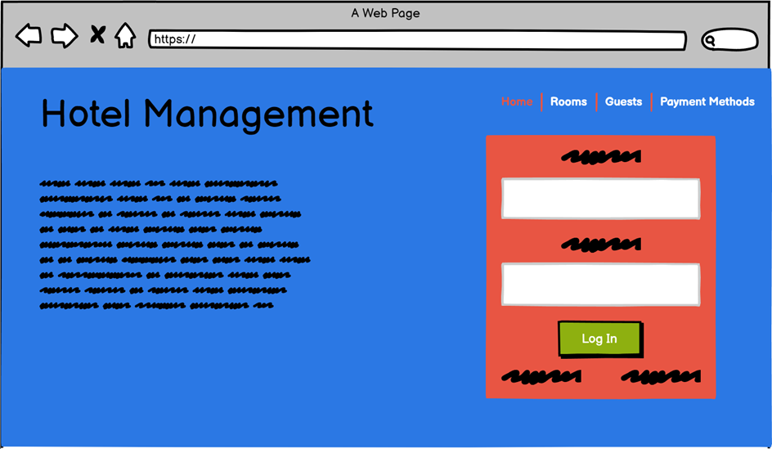

Slide 20
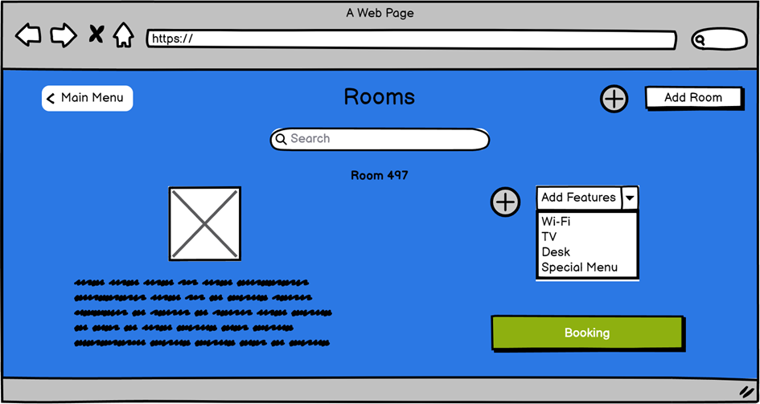

Slide 21
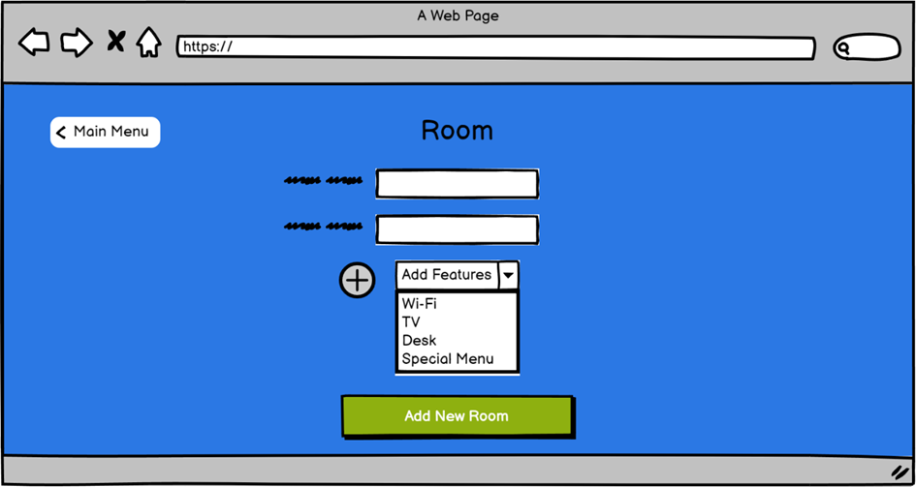

Slide 22
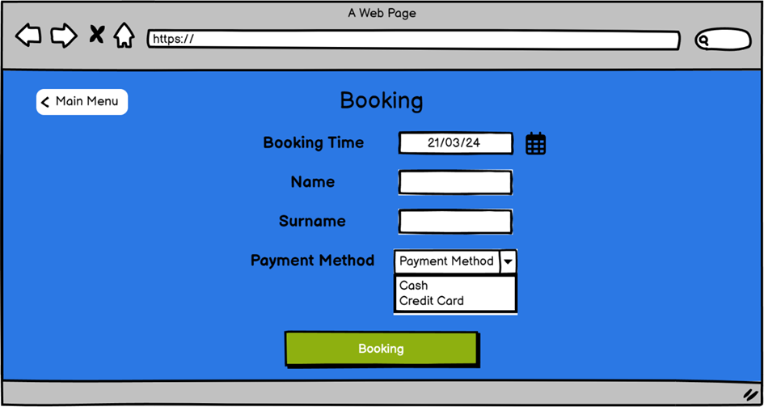

Slide 23
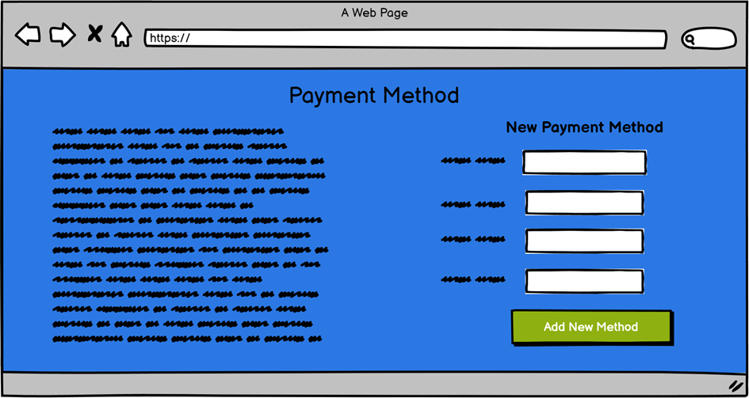

Slide 24
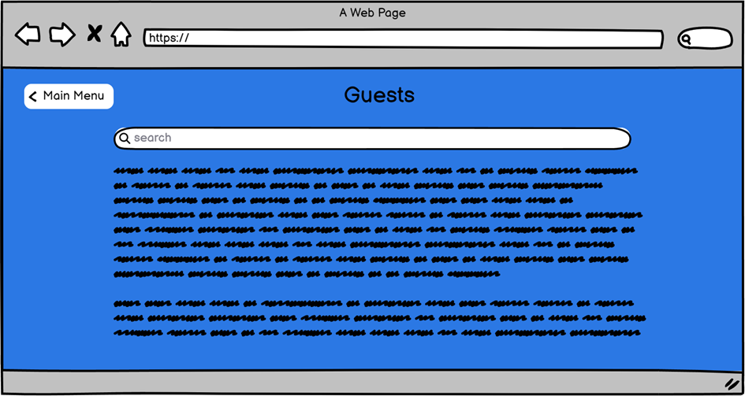

Slide 25
Thanks for listening!

